Slide 1
OOP
WEEK10 MUHAMMAD NAEEM AKHTAR

Slide 2
Contents
Polymorphism
Static vs Dynamic Binding
Virtual Functions
Overriding,
Overloading vs Overriding

Slide 3
What is Polymorphism?
The word “polymorphism” means having many forms.
A real-life example of polymorphism is a person who at the same time can have different characteristics.
A man at the same time is a father, a husband, and an employee. So the same person exhibits different behavior in different situations. This is called polymorphism.
Polymorphism is considered one of the important pillars of Object-Oriented Programming.
Notes:
In simple words, we can define polymorphism as the ability of a message to be displayed in more than one form.

Slide 4
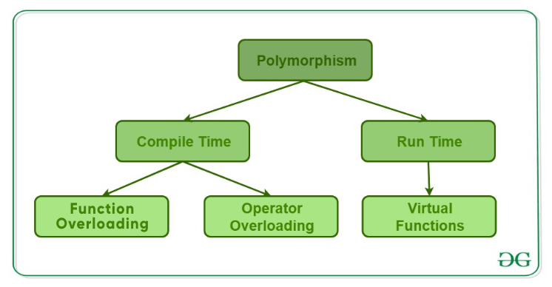
Types of Polymorphism

Slide 5
Compile Time Polymorphism
Function Overloading
See Function_Overloading1.cpp
Discussion on function overloading
Different return types???
Operator Overloading
See Operator_Overloading1.cpp
Notes:
Why is Function overloading not possible with different return types?
Function overloading comes under the compile-time polymorphism. During compilation, the function signature is checked. So, functions can be overloaded, if the signatures are not the same. The return type of a function has no effect on function overloading, therefore the same function signature with different return type will not be overloaded.
Example: if there are two functions: int sum() and float sum(), these two will generate a compile-time error as function overloading is not possible here.
Operator Overloading
C++ has the ability to provide the operators with a special meaning for a data type, this ability is known as operator overloading. For example, we can make use of the addition operator (+) for string class to concatenate two strings. We know that the task of this operator is to add two operands. So a single operator ‘+’, when placed between integer operands, adds them and when placed between string operands, concatenates them.

Slide 6
Early vs Late Binding
Static and Dynamic Binding

Slide 7
Runtime Polymorphism
Call to a member function will cause a different function to be executed depending on the type of object that invokes the function.
This type of polymorphism is achieved by Function Overriding.
Late binding and dynamic polymorphism are other names for runtime polymorphism.
The function call is resolved at runtime in runtime polymorphism.
In contrast, with compile time polymorphism, the compiler determines which function call to bind to the object after deducing it at runtime.

Slide 8
Run Time Polymorphism
Function Overriding
Function Overriding occurs when a derived class has a definition for one of the member functions of the base class. That base function is said to be overridden.
See Function_Overrinding0.cpp
Discussion

Slide 9
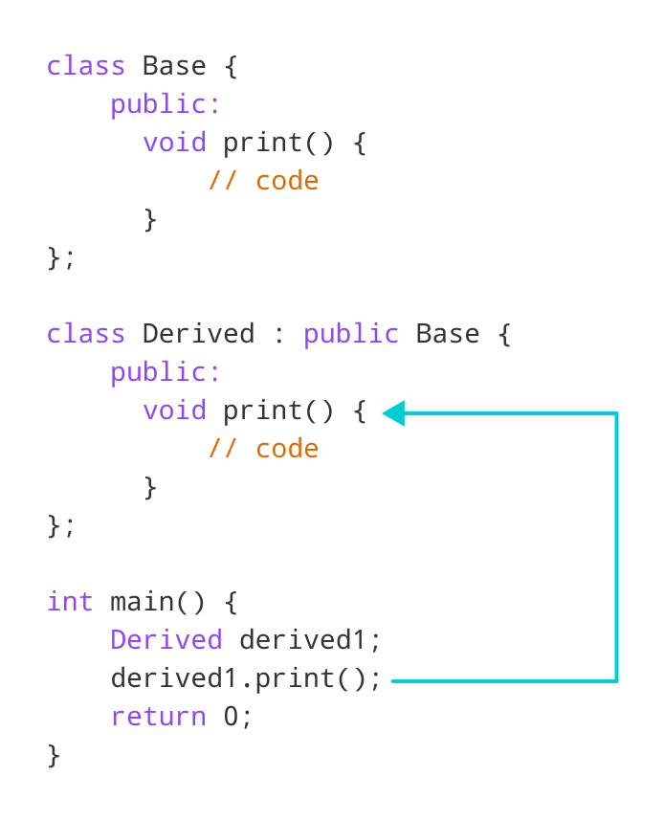
Run Time Polymorphism

Slide 10
Access Overridden Function in C++
To access the overridden function of the base class, we use the scope resolution operator ::
See example: Function_Overrding00.cpp,
See example: Function_Overriding000.cpp (next slide figure)

Slide 11
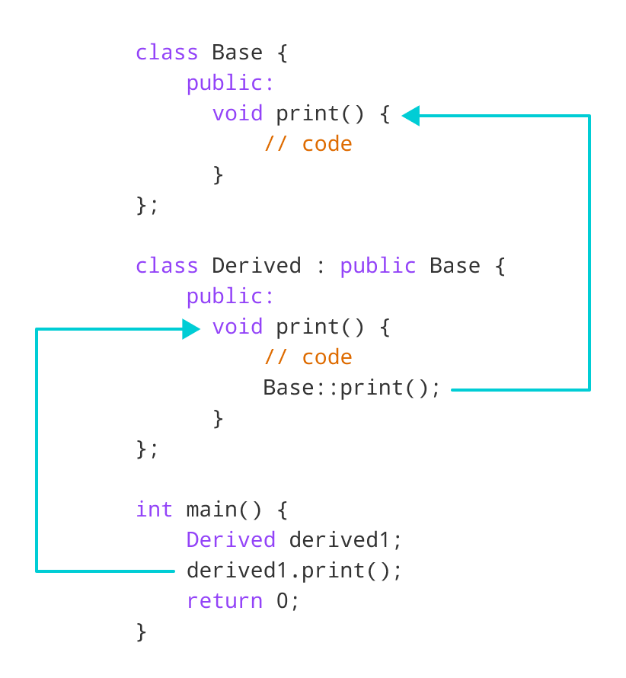
Access Overridden Function in C++
Notes:
Function_Overriding000.cpp explanation

Slide 12
Access Overridden Function in C++
We can also access the overridden function by using a pointer of the base class to point to an object of the derived class and then calling the function from that pointer.
See example: Function_Overrding1.cpp, Function_Overrding11.cpp
In order to override the Base function instead of accessing it, we need to use virtual functions in the Base class.

Slide 13
Run Time Polymorphism
Virtual Function
A virtual function is a member function that is declared in the base class using the keyword virtual and is re-defined (Overridden) in the derived class.
Some Key Points About Virtual Functions:
Virtual functions are Dynamic in nature.
They are defined by inserting the keyword “virtual” inside a base class and are always declared with a base class and overridden in a child class
A virtual function is called during Runtime
See Function_Overrinding2.cpp

Slide 14
Run Time Polymorphism
Virtual Function
A virtual function is a member function that is declared in the base class using the keyword virtual and is re-defined (Overridden) in the derived class.
It tells the compiler to perform late binding where the compiler matches the object with the right called function and executes it during the runtime.
This technique falls under Runtime Polymorphism

Slide 15
Run Time Polymorphism
Key Points (Reading Assignment)
In C++ what calling a virtual functions means is that; if we call a member function then it could cause a different function to be executed instead depending on what type of object invoked it.
Because overriding from derived classes hasn’t happened yet, the virtual call mechanism is disallowed in constructors.
Also note that objects are built from the ground up or follows a bottom to top approach.

Slide 16
Run Time Polymorphism
See example: Virtual1.cpp
In the above example:
We store the address of each child’s class Rectangle and Square object in s and
Then we call the get_Area() function on it,
Ideally, it should have called the respective get_Area() functions of the child classes but
Instead, it calls the get_Area() defined in the base class.
This happens due to static linkage which means the call to get_Area() is getting set only once by the compiler which is in the base class.
Solution????

Slide 17
Run Time Polymorphism
See example: Virtual2.cpp
What is the use of Virtual Function? Virtual functions allow us to create a list of base class pointers and call methods of any of the derived classes without even knowing the kind of derived class object.

Slide 18
Summary of Virtual Function
A virtual function is a function in a base class that is declared using the keyword virtual. Defining in a base class a virtual function, with another version in a derived class, signals to the compiler that we don't want static linkage for this function.
What we do want is the selection of the function to be called at any given point in the program to be based on the kind of object for which it is called. This sort of operation is referred to as dynamic linkage, or late binding

Slide 19
Pure Virtual Functions
It is possible that you want to include a virtual function in a base class so that it may be redefined in a derived class to suit the objects of that class, but that there is no meaningful definition you could give for the function in the base class.
We can change the virtual function area() in the base class to the following.

Slide 20
Pure Virtual Functions
Pure virtual functions are used
if a function doesn't have any use in the base class
But the function must be implemented by all its derived classes
Let's take an example,
Suppose, we have derived Triangle, Square and Circle classes from the Shape class, and we want to calculate the area of all these shapes.
In this case, we can create a pure virtual function named calculateArea() in the Shape. Since it's a pure virtual function, all derived classes Triangle, Square and Circle must include the calculateArea() function with implementation.
A pure virtual function doesn't have the function body and it must end with = 0. For example,
Notes:
class Shape { protected: int width, height; public: Shape(int a = 0, int b = 0) { width = a; height = b; } // pure virtual function virtual int area() = 0; };

Slide 21
Pure Virtual Functions
class Shape {
protected:
int width, height;
public:
Shape(int a = 0, int b = 0) {
width = a;
height = b;
}
// pure virtual function
virtual int calculateArea() = 0;
};
Notes:
class Shape { protected: int width, height; public: Shape(int a = 0, int b = 0) { width = a; height = b; } // pure virtual function virtual int area() = 0; };

Slide 22
Pure Virtual Functions
Note:
The = 0 tells the compiler that the function has no body and above virtual function will be called pure virtual function.
The = 0 syntax doesn't mean we are assigning 0 to the function. It's just the way we define pure virtual functions.
Notes:
class Shape { protected: int width, height; public: Shape(int a = 0, int b = 0) { width = a; height = b; } // pure virtual function virtual int area() = 0; };

Slide 23
Abstract Class
A class that contains a pure virtual function is known as an abstract class. In the above example, the class Shape is an abstract class.
We cannot create objects of an abstract class.
However, we can derive classes from them, and use their data members and member functions (except pure virtual functions).
That's why we must provide the implementation of calculateArea() in all of our derived classes. What will happen if we do not do so?

Slide 24
Characteristics of Abstract Class
A class is abstract if it has at least one pure virtual function.
We cannot create object of abstract class but we can have pointers and references of abstract class type.
See example: Abstract1.cpp
If we do not override the pure virtual function in derived class, then derived class also becomes abstract class.
See example: Abstract2.cpp
An abstract class can have constructors.
See example: Abstract3.cpp
An abstract class in C++ can also be defined using struct keyword.
Notes:
An abstract class in C++ can also be defined using struct keyword.
E.g. :
struct shapeClass
{
virtual void Draw()=0;
}

